Slide 1

JAVASCRIPT EVENTS
</>
EVENTS, REDIRECTION, DATE & TIME, & HOISTING

Slide 2
Events
HTML Events are the actions that happen in a Web document. For example, a user clicks on a button, or the browser is loaded.
JavaScript can listen these events and can react to them.
An HTML event can be something the browser does, or something a user does.
JavaScript can execute some code after an event is fired, using event listeners.
To react to an event on an element, you would attach an event listener to it as mentioned below in the example where we are showing text in h1 element by clicking on the button.
Event Listeners in JS
var button = document.querySelector("button");
button.addEventListener("click", function () {
document.getElementById("h1").innerHTML = "JavaScript is Awesome!";
});

Slide 3
Events
We can have multiple event listeners for a single event and all of them would be executed by JS when that event is fired.
Event Listeners in JS
myElement.addEventListener('click', functionA);
myElement.addEventListener('click', functionB);
Similarly, multiple event listeners for different events can be configured for a single element..
Event Listeners in JS
myElement.addEventListener('click', functionA);
myElement.addEventListener(‘dblclick', functionB);
As we can see, addEventListener() function takes two arguments, name of the event as first argument and the function to be fired when that event occurs as the second argument.

Slide 4
Events
If you've added an event handler using addEventListener(), you can remove it again using the removeEventListener() method.
Event Listeners in JS
myElement.removeEventListener('click’, funcToBeRemoved);
The recommended way of registering event listeners is using addEventListener(), but there are two other methods:
Event Listener properties
Inline Event Listeners (don’t use these)

Slide 5
Events
Event Handler or Event Listener Properties:
Elements that can fire events also usually have properties whose name is on followed by the name of the event. For example, elements have a property onclick. This is called an event handler or event listener property.
Event Handler Properties
var btn = document.querySelector('button');
btn.onclick = funtion () {
const rndCol = `rgb(${random(255)}, ${random(255)}, ${random(255)})`;
document.body.style.backgroundColor = rndCol;
}
With event handler properties, you can't add more than one handler for a single event unlike the addEventListener() method with which you can add multiple functions to be invoked when a single event is fired on an element..

Slide 6
Events
Inline Event Handlers:
Event Listeners can also be registered on an HTML element using attributes starting from on keyword, followed by the name of the event as mentioned in the code snippet.
Event Handler Properties
<button onclick="showText()">Show Text</button>
You can find HTML attribute equivalents for many of the event handler properties; however, you shouldn't use these — they are considered bad practice.
it is not a good idea to mix up your HTML and your JavaScript, as it becomes hard to read. Keeping your JavaScript separate is a good practice, and if it is in a separate file you can apply it to multiple HTML documents.

Slide 7
Events
Event Objects:
Sometimes, inside an event handler function, you'll see a parameter specified with a name such as event, evt, or e. This is called the event object, and it is automatically passed to event handlers to provide extra features and information.
Event Handler Properties
var button = document.querySelector("button");
button.addEventListener("click", function (event) {
document.getElementById("h1").innerHTML = "JavaScript is Awesome!";
});
Console.log(event);

Slide 8
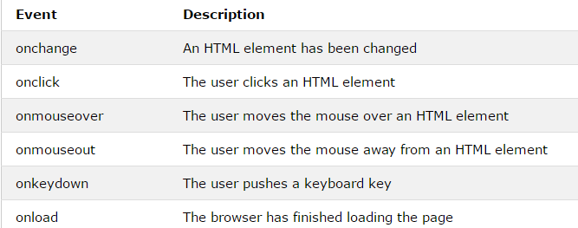
Events
Common Events:

Slide 9
--TASK--
Create an input field and a label. When someone starts entering text into the input field, the label should display 'typing.' (Hint: Use the keydown event.)

Slide 10
Any Questions?
THANKS!
Instructor: Umair Syed
Instructor 2: Farrukh Adeel
itsumairsyed@gmail.com
m.farrukhadeel@gamil.com
+92 309 0403499
+92 313 6732243
Quantum Learning Academy
Notes:
Js compile the var and function keyword first and declare them at the top of the program.

